Slide 1

Workplace Incident Reporting
Provided by:
Environmental Health and Safety (EHS)
Human Resources
Insurance & Risk Management

Slide 2
Learning Objectives
Identify workplace incidents that must be reported
Understand how to report incidents
Medical provider requirements
Know where to get assistance
Learn the benefits of prompt and accurate incident reporting

Slide 3
Employee or Student?
Triggers for “Employment”
  Paid employment
  Fellowships
  Assistantships
  Stipends – VURF

Slide 4
Identify workplace incidents that must be reported
OSHA Definition of Work-related incident (OSHA Standard 1904.5)
  An injury or illness is considered work-related if an event or exposure in the work environment either caused or contributed to the resulting condition
  Or
  Significantly aggravated a
  pre-existing injury or illness.
  Work-relatedness is presumed for injuries and illnesses resulting from events or exposures occurring in the work environment, unless an exception specifically applies.

Slide 5
What does “at work” mean?
On campus while you are working or walking between buildings
While traveling for business (in the course of doing business)
While working off campus for the University
In a parking lot or garage, while walking to or from your building during your normal work hours.

Slide 6
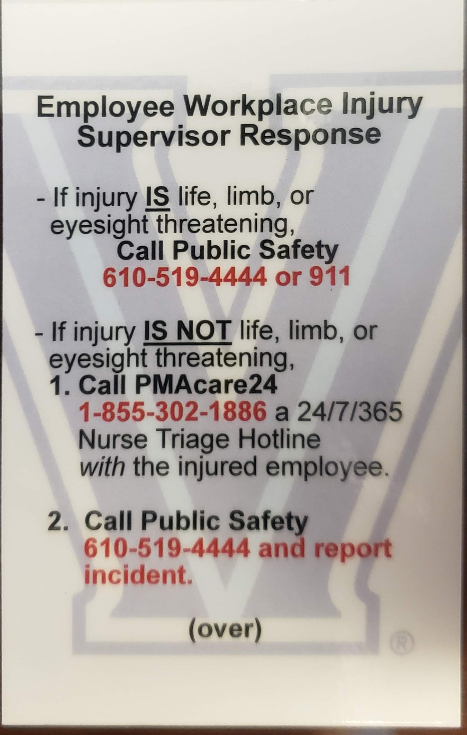
Employee Workplace Injury Supervisor Response
If injury IS life, limb, or eyesight- threatening,
Call Public Safety – 610-519-4444 or 911.
In case of emergency:
  Seek medical treatment immediately.
  Employee will be transported to nearest available hospital emergency room.
  Employee should be clear with ER staff that this is a work-related injury.

Slide 7
Employee Workplace Injury Supervisor Response (Continued)
If injury IS NOT life, limb, or eyesight threatening.
Call PMAcare24 1-855-302-1886, a 24/7/365 Nurse Triage Hotline with the injured employee
Call Public Safety 610-519-4444 to report incident

Slide 8
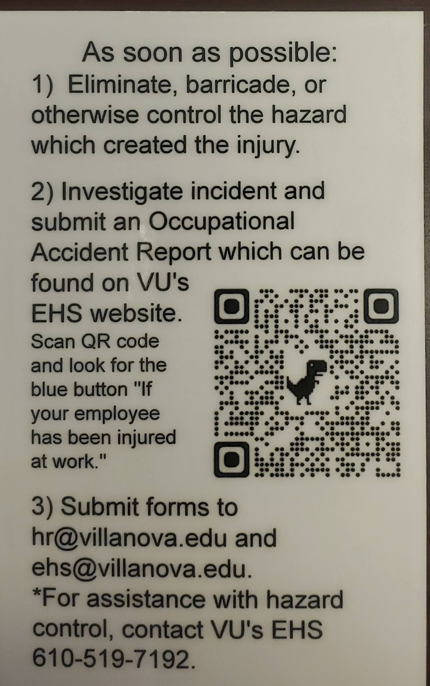
Employee Workplace Injury Supervisor Response (Continued)
As soon as possible:
Eliminate, barricade, or otherwise control the hazard which created the injury.
Investigate incident and submit an Occupational Accident Report to VU’s HR hrleaves@villanova.edu and VU’s EHS ehs@villanova.edu. Report can be found on the EHS website.
For assistance with hazard control, contact VU’s EHS 610-519-7192.

Slide 9
High Priority Incidents
Call EHS Director:
  In-patient hospitalization
  Loss of an eye
  Amputation
  Fatality
  610-519-7192
  717-319-7728

Slide 10
Medical Provider Requirements
  Panel Providers
        Employee must go to them for care for first 90 days following injury
        Covered under Worker’s Compensation Insurance
        Knowledgeable of our jobs and processes; better outcomes for employee and VU
        Concentra – King of Prussia

Slide 11
Concentra Telemedicine
  Referrable from PMACare24
  Treatable Conditions
    Minor sprains
    Bruises/contusions
    Minor burns
    Abrasions/scrapes
    Contact dermatitis/rashes
    Tendonitis/repetitive-use injuries
    Bloodborne pathogens exposures

Slide 12
Concentra Telemedicine
  Requirements
    Access to a quiet, private location for the visit
    A computer, smartphone, or mobile device with a webcam and microphone
    A valid photo ID or driver’s license
    An active email address and password of their choosing
    An internet connection

Slide 13
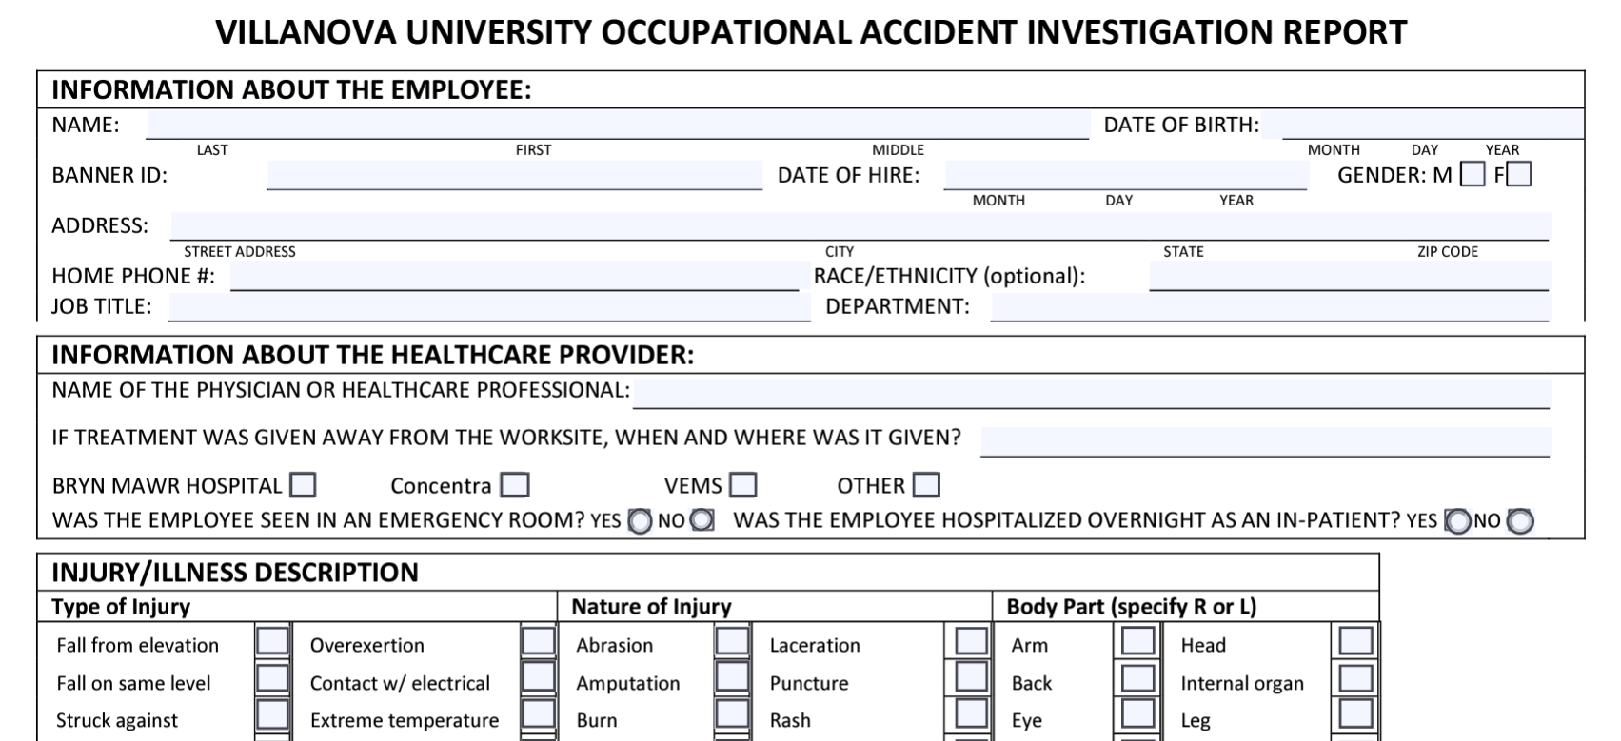
Complete an Investigation Report
Occupational Accident Investigation Reports should be filed within two (2) days of an accident or incident.
Completed reports should be emailed to HR (hrleaves@villanova.edu ) and EHS (ehs@villanova.edu)
Guidelines:
  Find facts, not fault, and assure the employee that is your goal.
  Don’t jump to conclusions.
  Assure the employee that this information will only be shared on a “need to know” basis.
  Contact HR at ext. 610-519-7900 or EHS at 610-519-7192 for assistance.

Slide 14
How to complete an investigation
Interview the employee and any witnesses.
Ask who, what, where, when, why, how.
Ask open ended questions (not yes/no).
Ask those interviewed to read the notes taken and confirm.
Check the status of any equipment involved (i.e., were the brakes engaged? What is the condition of the power cord?).
Determine root cause of the accident.
Develop corrective actions to prevent recurrence.

Slide 15
Finding the Root Cause – Five Why’s
Sometimes it’s hard to know where to start. Five Why’s is a basic investigation technique.
Ask “what happened?”
Then, in response to that answer, ask “Why?”
Repeat 5 times (5 Why’s). This technique is very effective in getting to the actual root cause of an injury.

Slide 16
Five Why’s: An Example
Situation: Employee is injured due to a fall
Q: What happened?
A: I fell
Q: Why(1) – Why did you fall?
A: I tripped over that cord.
Don’t give in to the temptation of stopping here.
Q: Why (2) – Why did you trip over the cord?
A: I didn’t see it.
Q:Why (3) – Why didn’t you see it?
A: I was carrying bags of food to the refrigerator.
Q: Why (4) – Why was the power cord there on the floor?
A: It’s an extension cord for the refrigerator.
Q: Why (5) – Why are you using an extension cord for the refrigerator?
A: Because there isn’t an outlet that the refrigerator cord can reach.
This is the root cause for the person’s fall.
Corrective action to prevent recurrence – install an outlet closer to the refrigerator.

Slide 17
“Report Only”
Contact PMA
Report the injury to Villanova’s Workers’ Compensation administrator, PMA insurance Group.
Call 1-855-302-1886 during normal business hours (Mon-Fri).
Weekend injuries can be reported to PMA on Monday morning.
Complete instructions are available on the Human Resources website.

Slide 18
Ask employee to sign important forms
Provide Employee with:
  PMA Panel Providers List and Medical Treatment for your Work Injury or Occupational Illness Information. This information can be found in the Workers’ Compensation Policy or by contacting HR.
  Once signed, submit form to Human Resources and EHS.
    ehs@villanova.edu
    hrleaves@villanova.edu

Slide 19
Information Supervisors must provide to PMA
About the employee: About the injury:
Name What happened
Home Address When did it happen
Phone Number Type of injury (sprain,
Gender laceration, etc.)
Marital Status Body part affected
Number of dependents Name(s) and phone number(s)
Birth date of any witnesses
Date of hire
You will gather this information in your Occupational Accident Investigation Report, so have your report handy!

Slide 20
Employee (1) Injury Management Process
Employee Injured
Employee notifies supervisor ASAP
Supervisor connects Employee to Care (2)
Is emergency treatment required? (2)
Did injury occur “at work”?
Employee treats with personal physician
Yes
No
Yes
No
Call Public Safety Transport to Emergency Room
Call PMAcare24
1-855-302-1886, a 24/7/265 Nurse Triage Hotline, with the injured employee
Employee must treat with Villanova “panel” providers for 1st 90 days (3)
Supervisor completes Occupational Accident Injury Investigation within 2 days (4)
All employees – students, faculty, staff
Supervisor calls Public Safety at 94444 OR 610-519-4444. Public Safety works
with injured employee to
determine appropriate level of care.
Employee arranges appointment
Complete instructions on HR website (Leaves of Absence)
Supervisor contacts PMA within 24 hours of injury (4)

Slide 21
Employees Workplace Injury Response
The injured employee is responsible for reporting the work-related injury immediately to his/her department head/supervisor.
Worker’s Compensation is a no-fault, state-mandated program, and employees are eligible for benefits regardless of who was at fault.
To ensure that medical treatment costs will be paid by PMA (Villanova’s insurer), employee must be seen by a physician or healthcare provider on the Villanova panel provider list for the first 90 days of treatment. The panel provider list can be found on the HR website.

Slide 22
How to Report
Near Miss/Hazard Incidents
EHS Website
Work Order
Call EHS
610-519-3801

Slide 23
Know where to get assistance
Villanova Environmental Health & Safety Department ehs@villanova.edu; 610-519-3801.
Villanova EHS: Director, Matt Pollart, 610-519-7192 matthew.pollart@villanova.edu
Concentra Urgent Care, Occupational health service in King of Prussia, 170 N. Henderson Road, Suite 306, King of Prussia, PA 19406; 610-337-1558; Hours: Monday-Friday 8:00 a.m. – 5:00 p.m.
PMA, 1-888-476-2669

Slide 24
PMA – Villanova Department Location Codes
W000000001 | PUBLIC SAFETY
W000000002 | FACILITIES - OTHER
W000000003 | FACILITIES - MAINTENANCE
W000000004 | FACILITIES - GROUNDS
W000000005 | FACILITIES-CUSTODIAL SERVICES
W000000006 | ATHLETICS
W000000008 | THEATRE
W000000010 | DINING SERVICES
W000000011 | MAIL SERVICES AND GRAPHICS
W000000012 | UNIT/TELECOM/WILDCARD
W000000014 | FACULTY/STAFF/GRAD ASSTS-ENGINEERING
W000000015 | FACULTY/STAFF/GRAD ASSTS-ARTS & SCIENCES
W000000016 | FACULTY/STAFF/GRAD ASSTS-COLLEGE OF NURSING
W000000017 | FACULTY/STAFF/GRAD ASSTS-VILLANOVA SCHL OF BUS
W000000018 | FACULTY/STAFF/GRAD ASSTS-LAW SCHOOL
W000000019 | ALL OTHER STAFF
W000000021 | FACULTY/STAFF/GRAD ASSTS-COLLEGE OF PROFESSIONAL STUDIES
W000000022C | CABRINI CAMPUS

